Slide 1





TOGETHER
김태영
PL
박아란
PM
온수인
TM
이소영
TM
노성봉
TM

Slide 2
CONTENTS
Goal achievement service to help you with consistent habits
프로젝트 개요
주요기능
사용한 언어
조원별 역할
프로젝트 시연
일정표
진행상의 이슈

Slide 3




TOGETHER
Goal achievement service to help you with consistent habits
꾸준한 습관을 돕는 목표 달성 서비스
CHALLENGERS(챌린져스) 애플리케이션을 모방한 TOGETHER PROJECT
REWARD
100% 달성하면 추가 상금!
실패 시엔 차감됩니다
SELECT
BETING COIN
PHOTO SHOT
원하는 TOGETHER 선택
참가비를 내고 신청
실천한 TOGETHER는 사진으로 인증

Slide 4

MAIN FUNCTION
Goal achievement service to help you with consistent habits
TOGETHER 개설
로그인 / 로그아웃
회원가입
TOGETHER 참여
회원정보수정
TOGETHER 수정
좋아요
인증하기
카테고리
결제하기
검색하기

Slide 5





DEVELOPMENT TOOLS
Goal achievement service to help you with consistent habits
eclipse
sqldeveloper
Visual Studio Code
GitHub
Sourcetree

Slide 6





DEVELOPMENT LANGUAGES
Goal achievement service to help you with consistent habits
Java
ORACLE
HTML5 & CSS3 & JS
JSP
jQuery

Slide 7
SCHEDULE
Goal achievement service to help you with consistent habits
2021.02
2021.03
1주차 | 2주차 | 3주차 | 4주차 | 5주차 | 6주차 | 7주차
아이디어 선정
화면구성 (KAKAO OVEN)
DB설계
DB SQL 도출
클래스 설계
프로젝트 화면 구현

Slide 8

ROLE BY GROUP
Goal achievement service to help you with consistent habits
0
0
TOGETER
MEMBERS
김태영
박아란
노성봉
온수인
이소영
개설하기
참여하기
검색하기
카테고리
좋아요
HEADER, FOOTER
TOGETHER 디테일
TOGETHER 수정하기
인증 모아보기
결제하기
로그인
로그아웃
마이페이지
충전하기
정보수정
아이디 찾기
비밀번호 찾기
아이디 중복
닉네임 중복
인증하기

Slide 9
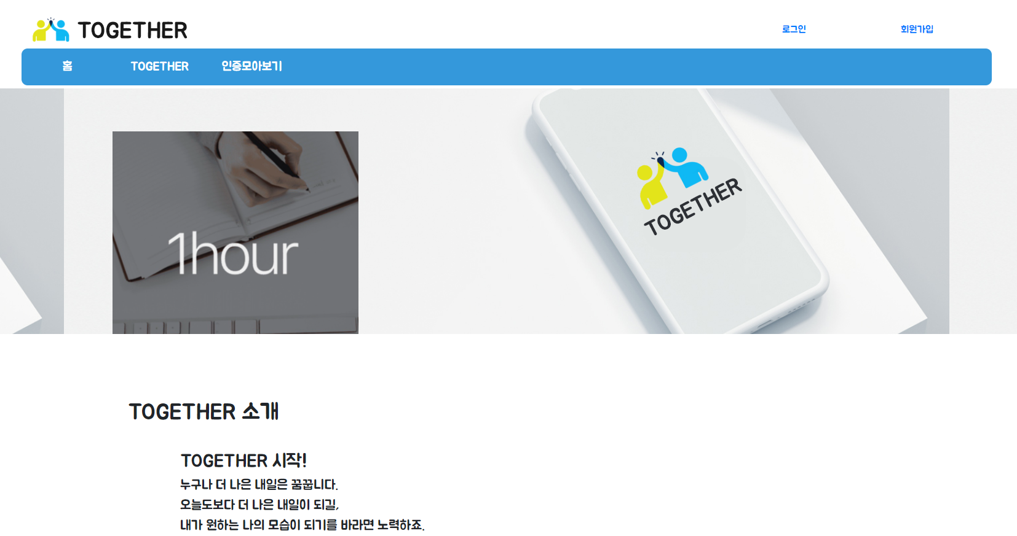

MAIN PAGE
Goal achievement service to help you with consistent habits

Slide 10
MAIN PAGE
Goal achievement service to help you with consistent habits

Slide 11
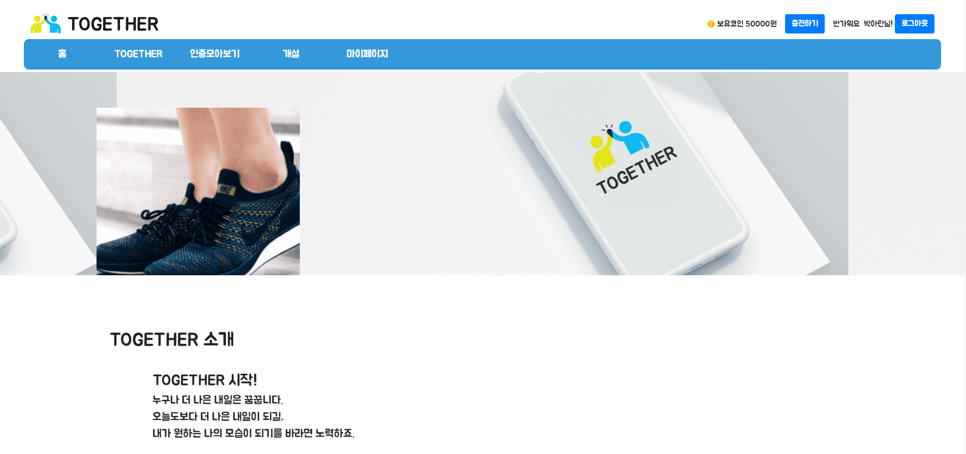
MAIN PAGE
Goal achievement service to help you with consistent habits

Slide 12
MAIN PAGE
Goal achievement service to help you with consistent habits

Slide 13
MAIN PAGE
Goal achievement service to help you with consistent habits

Slide 14
MAIN PAGE
Goal achievement service to help you with consistent habits

Slide 15
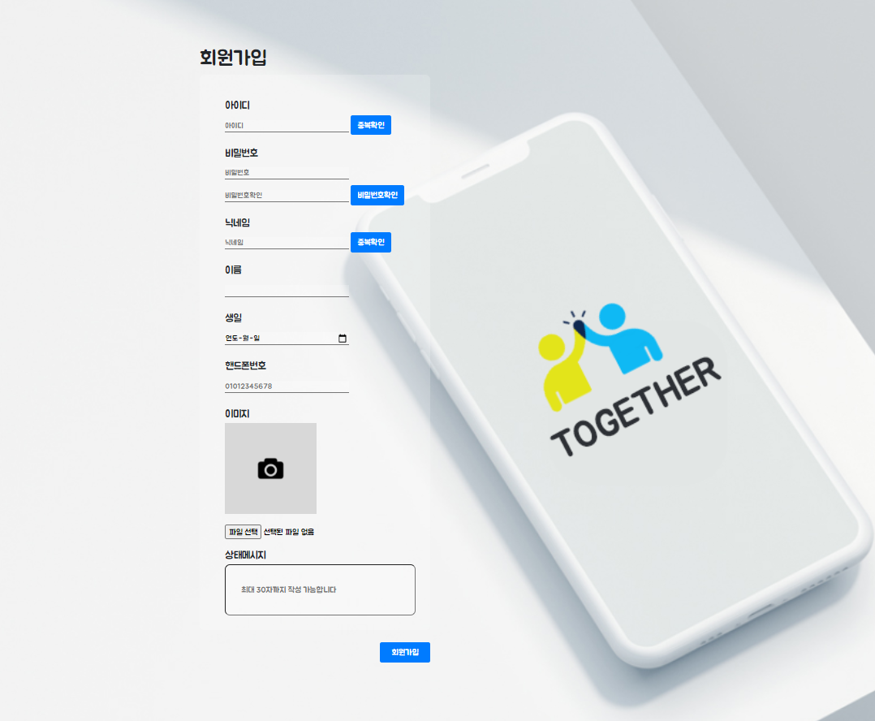
SIGNUP PAGE
Goal achievement service to help you with consistent habits

Slide 16
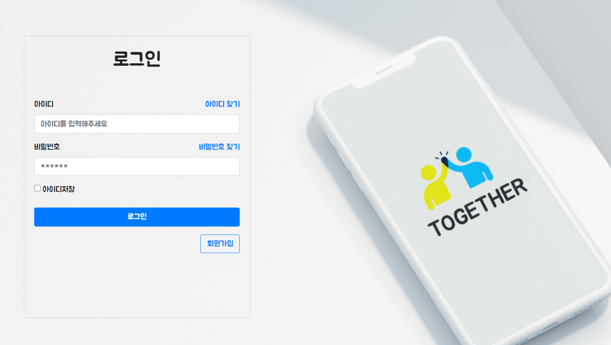
LOGIN PAGE
Goal achievement service to help you with consistent habits

Slide 17
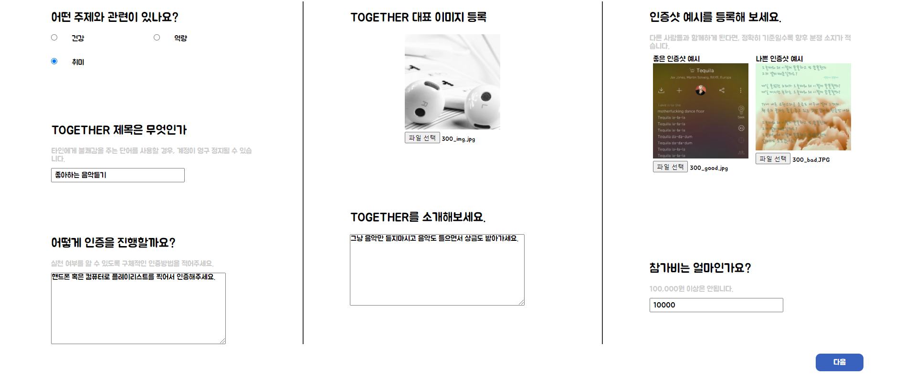
CREATE
Goal achievement service to help you with consistent habits

Slide 18
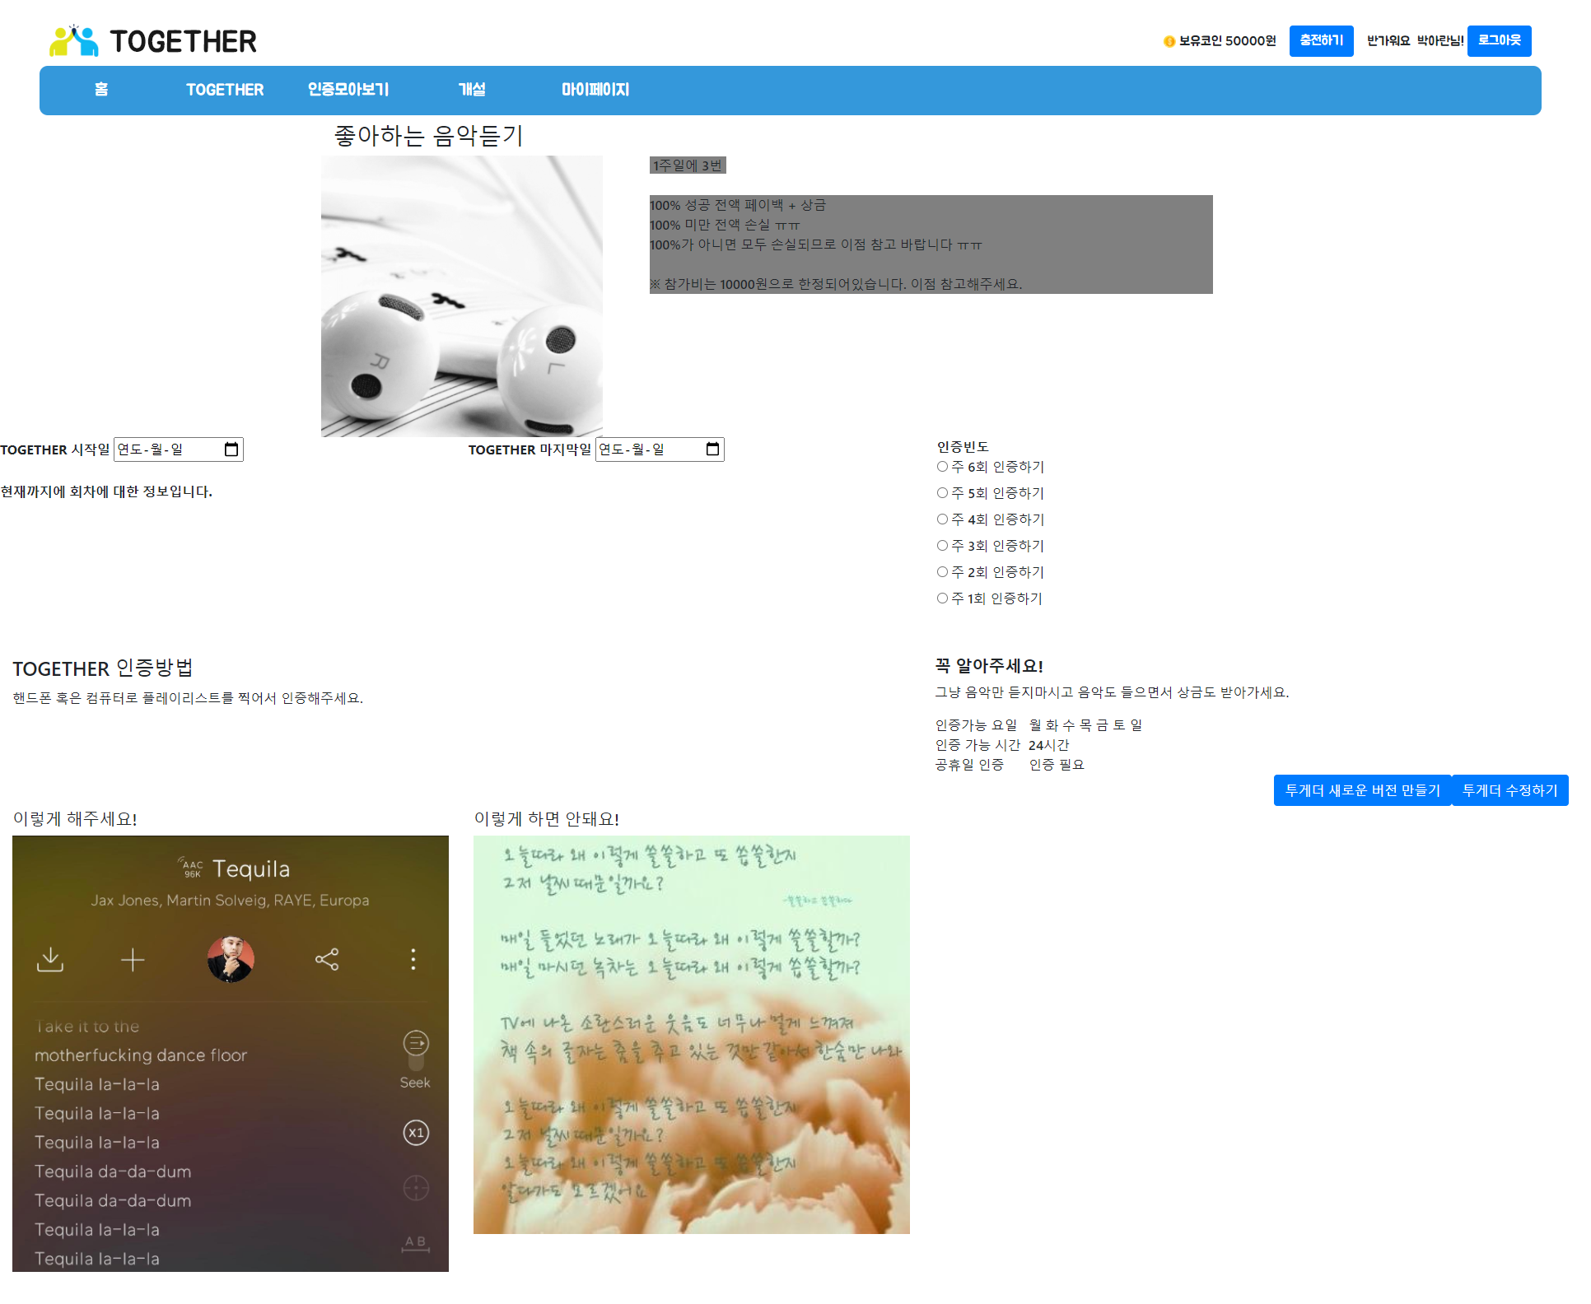
UPDATE
Goal achievement service to help you with consistent habits

Slide 19
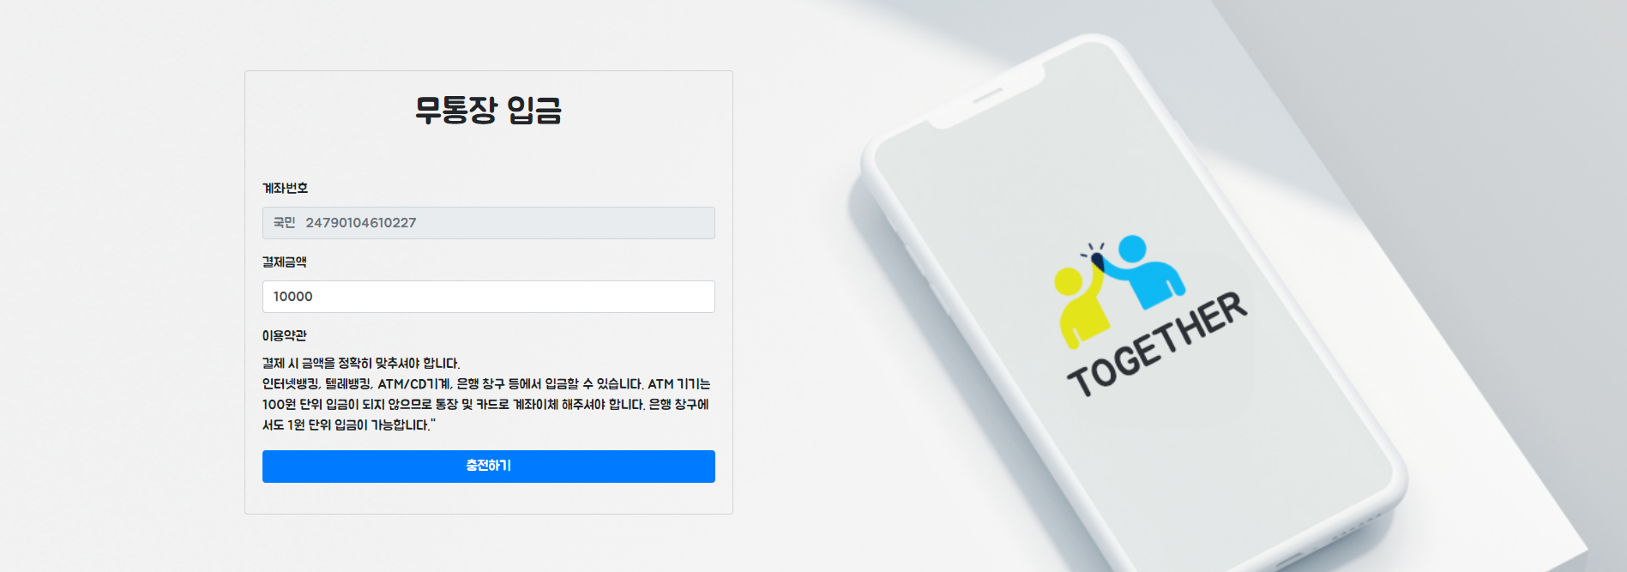
CHARGE
Goal achievement service to help you with consistent habits

Slide 20
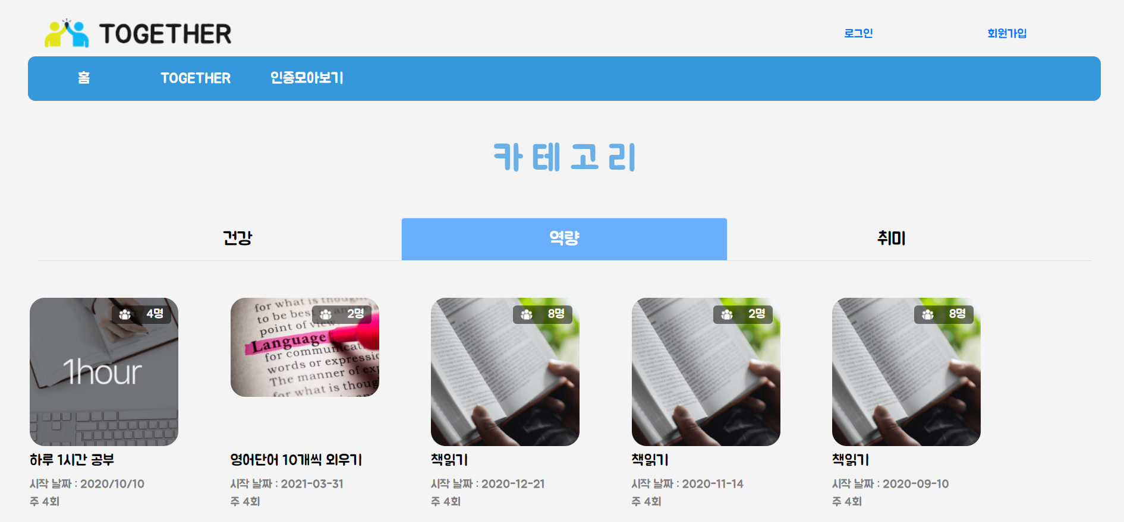
CATEGORY
Goal achievement service to help you with consistent habits

Slide 21
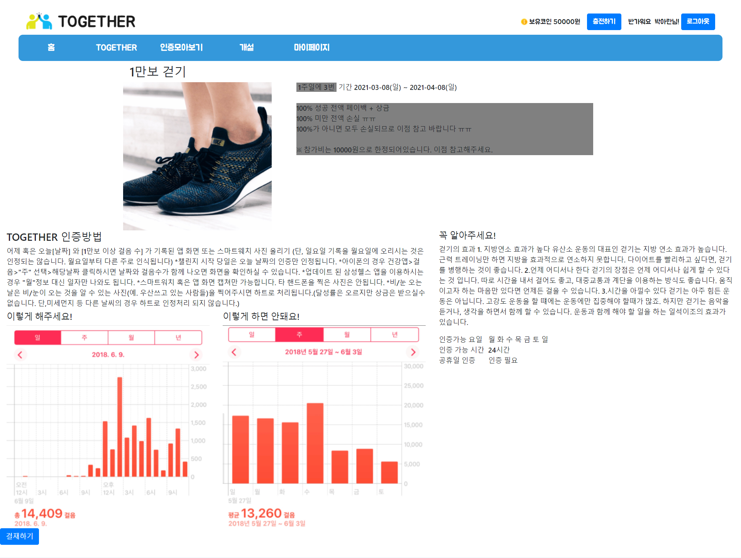
TOGETHER
Goal achievement service to help you with consistent habits

Slide 22
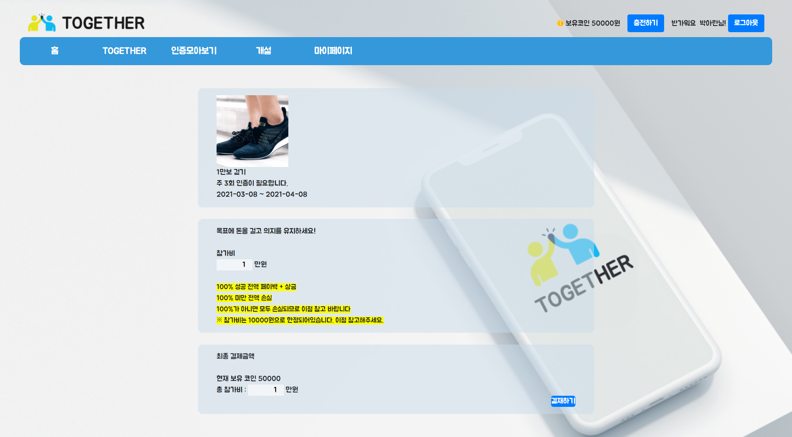
PAY
Goal achievement service to help you with consistent habits

Slide 23
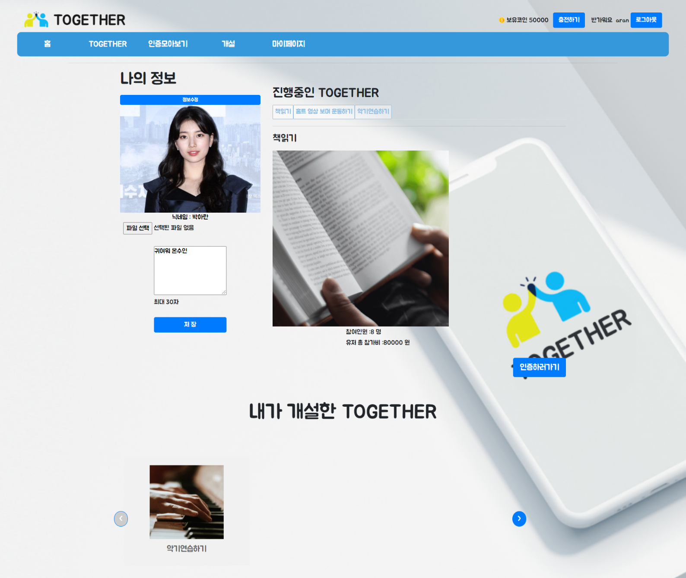
MYPAGE
Goal achievement service to help you with consistent habits

Slide 24
MYPAGE
Goal achievement service to help you with consistent habits

Slide 25
MYPAGE
Goal achievement service to help you with consistent habits

Slide 26
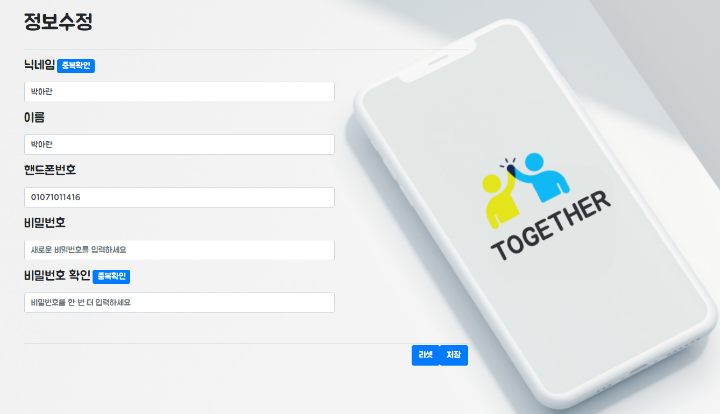
MYINFO
Goal achievement service to help you with consistent habits

Slide 27
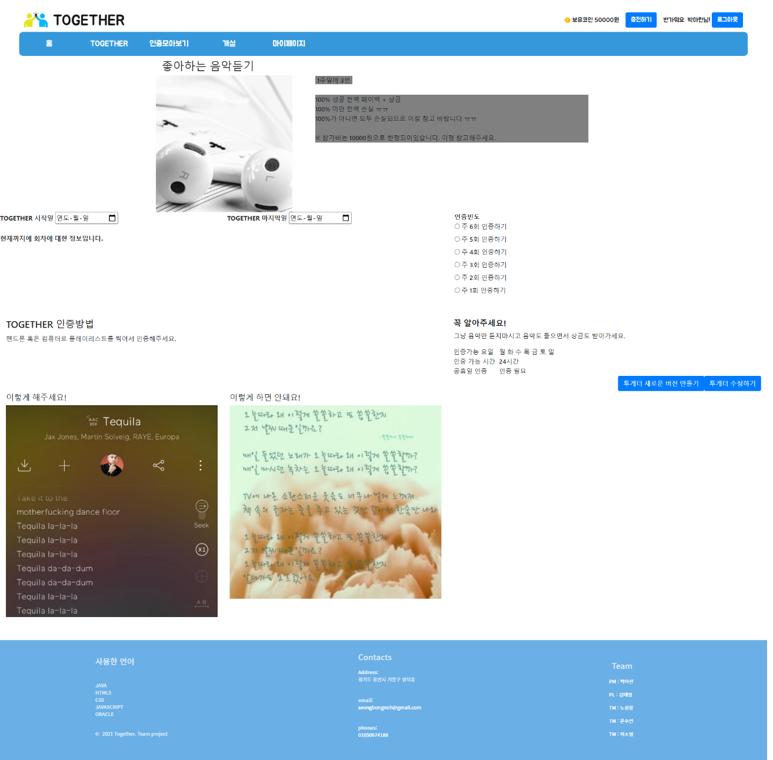
VERSION
Goal achievement service to help you with consistent habits

Slide 28
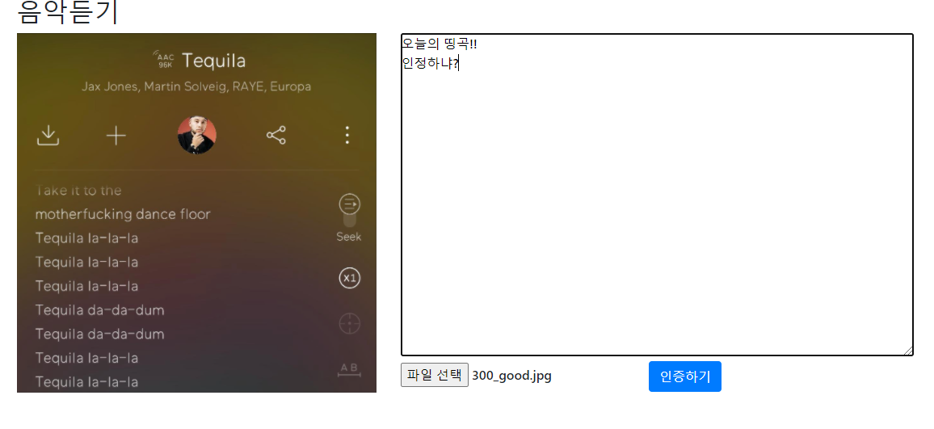
CERTIFICATIONG
Goal achievement service to help you with consistent habits

Slide 29
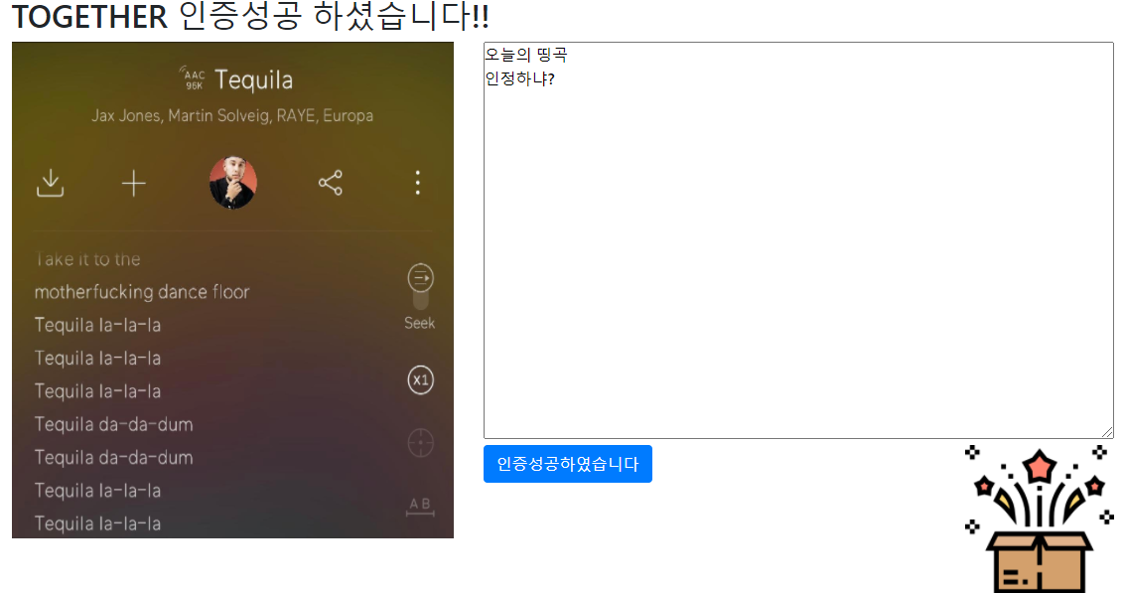
CERTIFICATIONG SUCCESS
Goal achievement service to help you with consistent habits

Slide 30
MAIN PAGE
Goal achievement service to help you with consistent habits

Slide 31
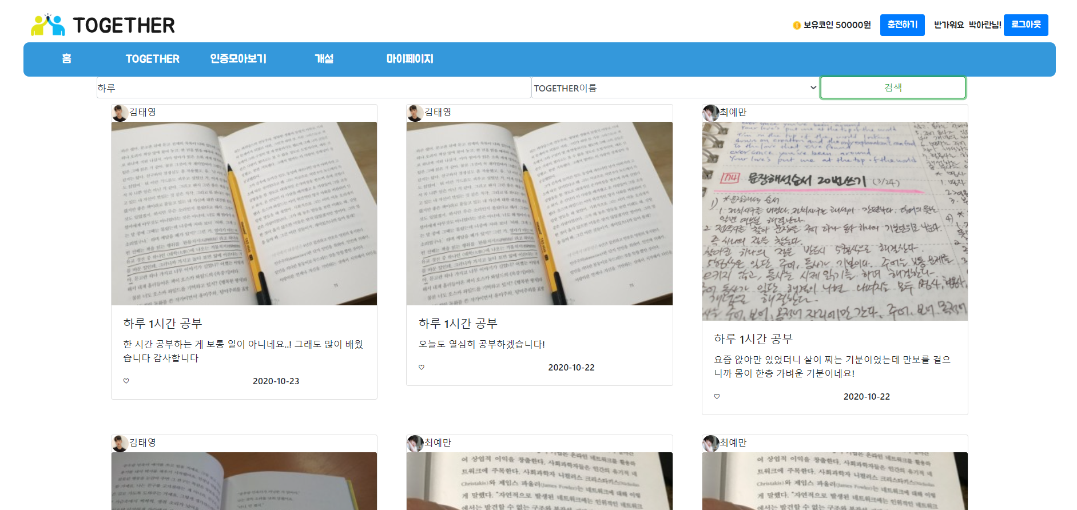
ALL PHOTO
Goal achievement service to help you with consistent habits

Slide 32
ISSUE
Goal achievement service to help you with consistent habits
페이징 생략
투게더, 인증샷 삭제
인증 모아보기 미흡
예외처리 미흡
UI 개선
인증절차 관련 프로세스

Slide 33

URL
Goal achievement service to help you with consistent habits
http://192.168.0.13:8889/together/

